Slide 1
Maturity Model for Microsoft 365 Practitioners
Maturity Model artifacts and overview
March 2021
Emily Mancini, Sympraxis Consulting | @eemancini Marc Anderson, Sympraxis Consulting | @sympmarc
Simon Doy, iThink 365 | @simondoy
Simon Hudson, Novia Consulting | @simonjhudson
Initiative started by Sadie Van Buren as SharePoint Maturity Model in 2010
Notes:
EMILY

Slide 2

v
Agenda
Practitioner overview
Picture time with the Together Mode!
Introduction to the Maturity Model
Latest artifacts for the Maturity Model
Monthly Discussion
How to get more involved
Notes:
EMILY

Slide 3

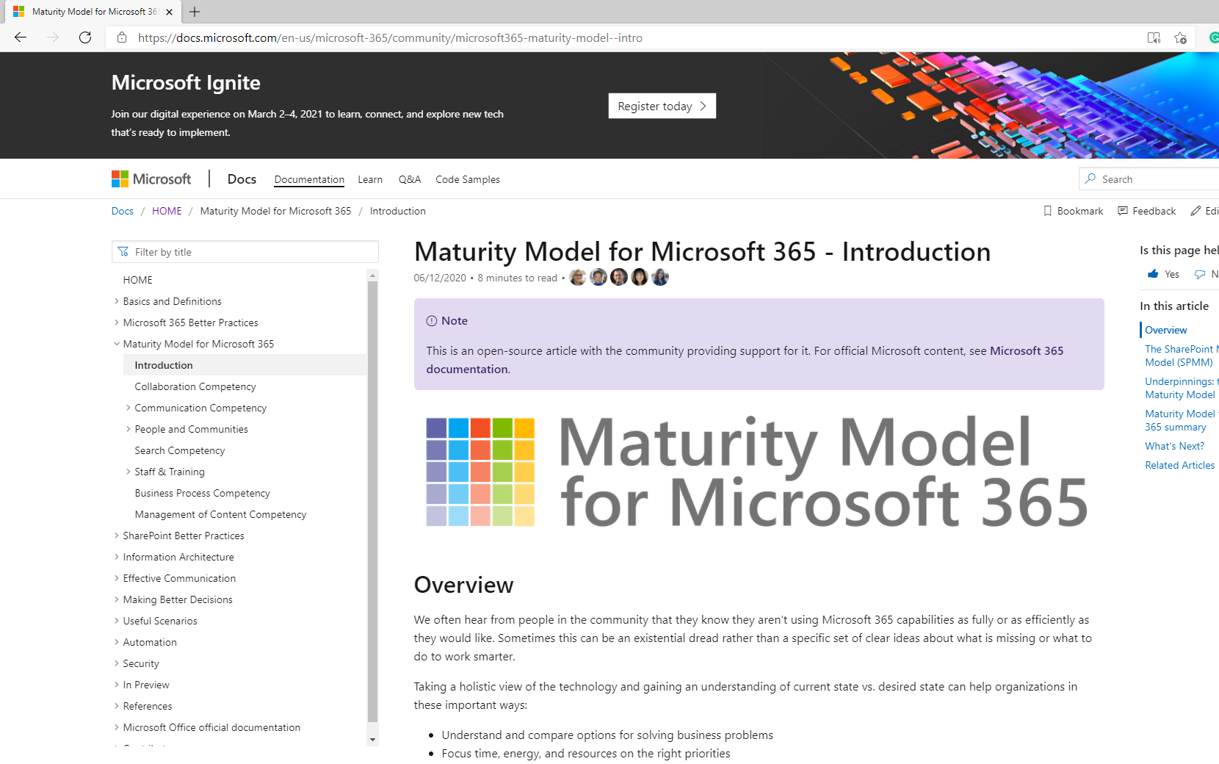
OVERVIEW
Practitioners for
Maturity Model
for Microsoft 365
https://aka.ms/sharing-is-caring
Notes:
EMILY (5 min)

Slide 4

Practitioners of MM4M365
Safe space to hone your pitch, test your thoughts, or decide how to promote your use of the Maturity Model
Discussion-based monthly meeting
Highlights of new assets
Understanding the competencies
Mapping technology to maturity levels and competencies
Running a workshop
Measuring maturity
Sharing anecdotes and success stories
Feedback on the maturity model
Notes:
EMILY

Slide 5
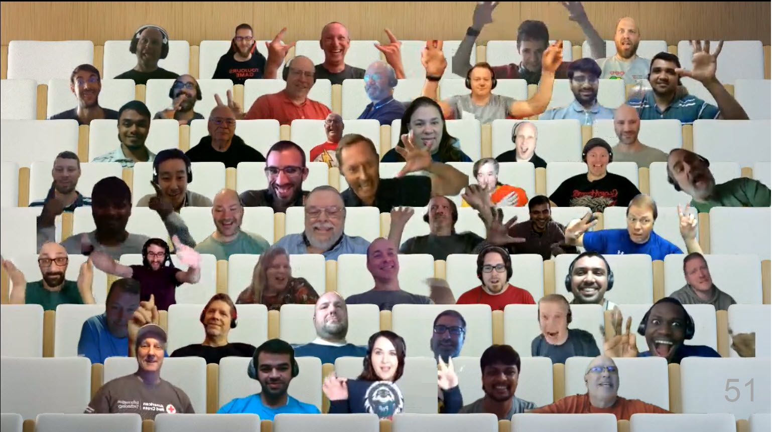

Optional picture time!
Video on and we’ll grab a Together Mode pic with those who are willing to do this.
We are together in this as a community!

Slide 6
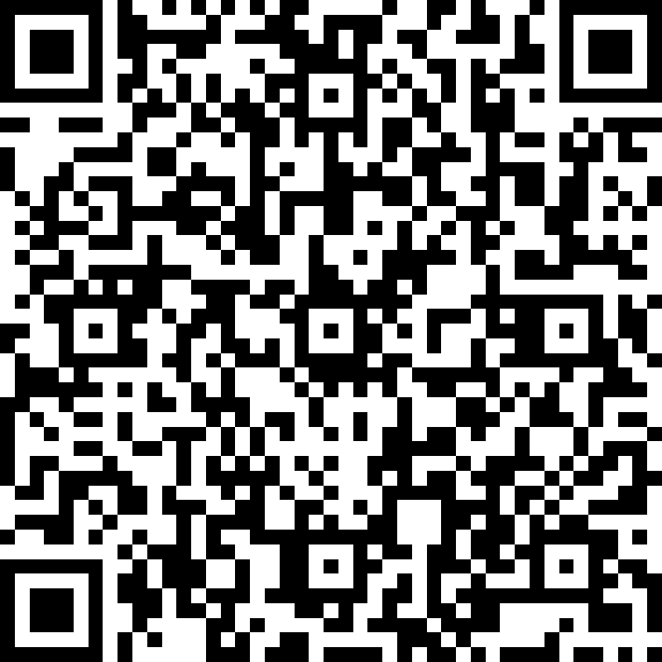
Where are you on your journey with the Maturity Model? - Heard of it but have no engaged - Scanned it a bit - Actively reading the articles - Using the Maturity Model in my org
https://symp.info/MM4M365Poll

Slide 7
INTRO
Maturity Model
for Microsoft 365
https://aka.ms/m365-community-docs
Notes:
SIMON, SIMON, MARC (15 min)

Slide 8








MM4M365 aligns the company on what can and will be done across the platform
Improve organization through use of technology
Benchmark company and department
Select appropriate approach
Develop an organizational business and technical roadmap based on:
What's possible
What's desired
Organization's culture and drivers
Lead and support strategic planning, with senior management
Align implementation needs and objectives
Discuss use of the platform with IT – not just technology
Socialization tool
Notes:
SIMON D
-Improve organization: this technology is most successful when we are using it to solve existing challenges in the organization. Maybe you are struggling with raising transparency in decision making- this is a great opportunity for SP communication sites and news.
-Benchmark company and department: provides a rubric to measure the current state which will be critical in measuring growth and tracking ROI to share with stakeholders or decision makers. Collaboration and communication are softer topics so this develops the language to begin measuring it all. M365 is so much more than usage statistics because we are shifting the way people are working and communicating to solve these real-world problems
-Select appropriate approach - Not one size fits all. Your company size, culture, goals, and industry all have impacts of what is the right maturity level for your organization. A 6 person company may never need to be at the 500 level for Communication. This model does not dictate any levels as better than others but instead focuses on the impacts so you can choose which matter the most to support your objectives.
-Develop an organizational business and technical roadmap: Now that we know current state and identified future state, you can use the How To articles to navigate a plan to get there which enables you to lead and support strategic planning, with senior management.
-Align implementation needs and objectives- maybe you are at the beginning of your journey, your current state is Level 0 so you can choose which level you want to begin. Some organizations might need to begin at 300 for M365 to be impactful. Aligning on impact allows you to focus the tradition requirements conversation for M365 on the outcome objectives which is really about the change you are seeking in working better together.
-Discuss use of the platform with IT – not just technology: expanding IT’s understanding past the systems themselves to the outcome objectives it supports
-Socialization tool: Majority of your colleague using M365 aren’t IT professionals and don’t spend the amount of time we all do understanding the platform. The Maturity Model is a cliff’s notes version of what is possible. Useful artifact to share with your colleagues to increase their understanding of the platform. Even better- it is community maintained reducing your individual burden of creating these resources for the org!

Slide 9





Approach for building the Maturity Model
Non-partisan, not driven by today’s features
Led by business need, not technology features
Identifies key business and technical competencies
Evaluates current state
Applicable to various roles in the organization
Notes:
SIMON D
If a purpose of developing the MM is to enable management ‘buy-in’ then we didn’t want it to be technology or feature focused.
The M365 platform is vast and changes rapidly, but business needs are common and slower. We concentrated on defining a set of business competencies, that resonate with M365 but underpin business activities.
We want to be able provide tools, not just information. These would allow organisations to figure out where they are in any function or department and what ‘better’ entails.
Not only should the MM for M365 not be about features, but it shouldn't be about IT either; so we built it using common language so that all sorts of business roles can use the model.

Slide 10
MM4M365 has evolved with the platform
Published Competencies
Open Competencies
Supporting Articles
Business Process
Data & Analytics
Principles of…
Collaboration
Infrastructure*
Search
Communication
Communication
*In progress
Management of Content
How to elevate…
People & Communities
Communication
Search
People & Communities
Staff & Training
Staff & Training
Customization & Development
Notes:
SIMON H
We thought about the underpinnings of businesses, the competencies and processes an organization needs to run successfully. We came up with a list, then argued about how to structure these – which were ‘parent’ competencies and which things might be themes (such as governance or security) that run through competencies – we might have got it right.. The key thing is that it wasn’t led by the technology. We have tried to push the envelope of thinking – so you may find some surprising things in some of the competencies; such as including email in collaboration.
We are attempting a broader approach, more geared around the business needs and functions.. We think we have captured a comprehensive set of business competencies, though perhaps you an suggest more…
As you will see in a moment, there are sub-layers and common categories within the competencies.
It’s not all done yet, so feel free to help us with completing the push.
We also realised that it doesn’t stop with the competencies, so we are wrapping related guidance and tools around them; including underlying business principles for some competencies, what it takes to step up through levels and practical advice on implementing the levels. Some of these will have technical details of features in M365 to employ.

Slide 11
MM4M365 provides benchmarks to measure your organization
Maturity Level | Description | Keywords
Level 500 Optimizing | Deliberate and systematic process improvement/optimization Focus is on continually improving process performance Addressing statistical common causes of process variation and iterative process improvement | Optimal, systematic, statistical, improvement-focus, automated, assured, proactive
Level 400 Predictable | Actively managed in accordance with agreed processes and has tracked metrics Effective achievement can be evidenced across a range of operational conditions Process has been tested and refined Process users demonstrate competence | Productive, interactive, responsive, enhanced, effective, adaptable, quality
Level 300 Defined | Defined and standardized Signed off, managed process Limited validation of effectiveness, doesn’t include edge cases Process users demonstrate familiarity | Documented, policy-driven, planned, controlled, stable
Level 200 Managed | Key processes defined but not standardized, uniformly or strongly applied Some ability to demonstrate consistent outcomes Limited buy-in from staff and management Widespread inconsistency and resistance | Routine, legacy, fire-fighting, variable, personally managed
Level 100 Initial | Default, starting/exploratory state People driven processes, lacking documentation and discipline Many ways of doing the same thing (with variable results) Characterised by inefficient legacy approaches and pockets of unmanaged innovation | Ad hoc, reactive, uncontrolled, chaotic, unstable, not designed, not designed
Source: https://docs.microsoft.com/en-us/microsoft-365/community/microsoft365-maturity-model--intro
Notes:
SIMON H

Slide 12
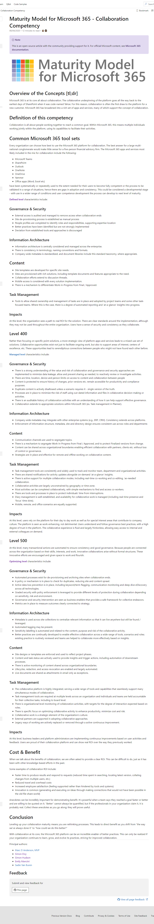
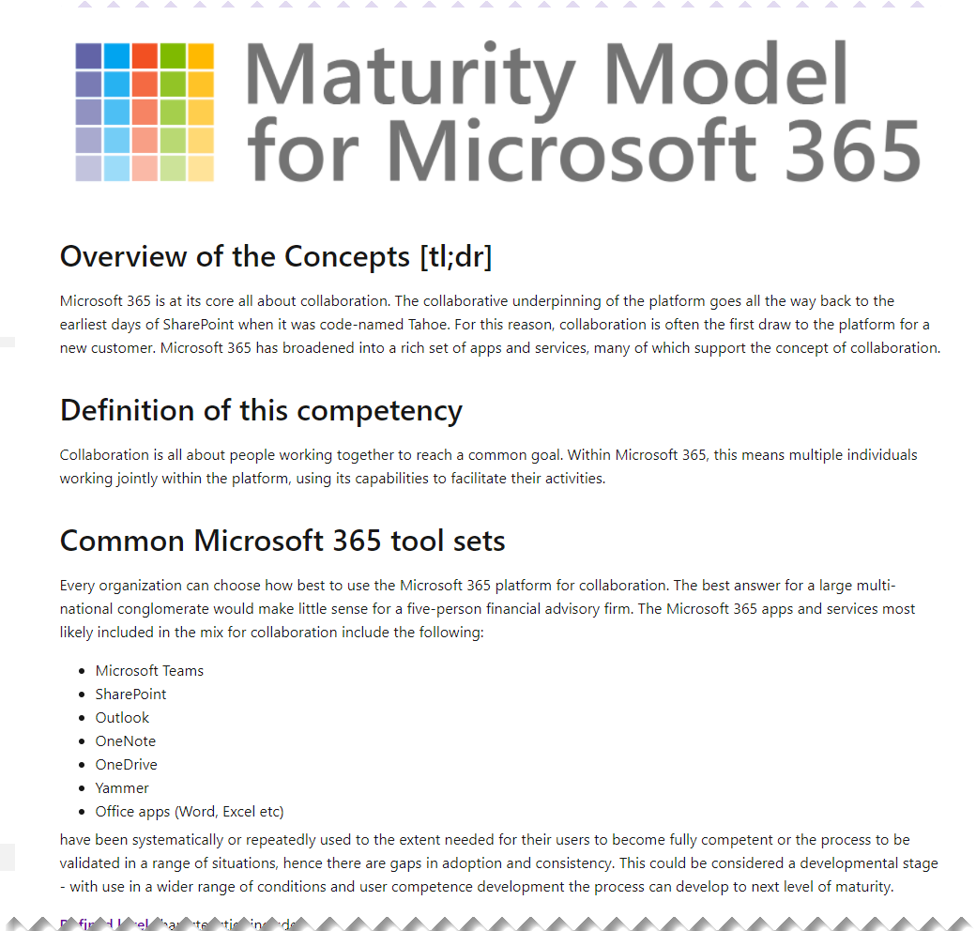
Source: https://docs.microsoft.com/en-us/microsoft-365/community/microsoft365-maturity-model--collaboration
Notes:
MARC
Some of the documents are pretty big; this is the collaboration one. However, we have tried to ensure they are consistent in flavour, structure and style, so that you can easily grab different competencies and jump straight in.

Slide 13
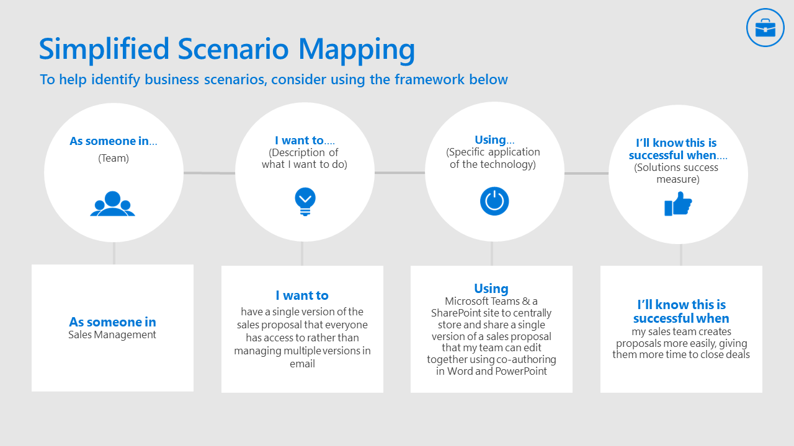
MM4M365 supports your adoption journey
Adoption Guides: https://adoption.microsoft.com/guides/
Phase 1:
Define your business strategy
Identify business scenarios
Assess readiness
Phase 3:
Encourage ongoing engagement (feedback cycles)
Office 365 Teamwork Champions: https://aka.ms/O365Champions
Notes:
EMILY
Adoption Guide Workbook: Maturity model helps with common language around assessing readiness, identifying targets, and anticipating impact
Business scenario mapping at its most simple form is defining a successful process journey for an employee. You can align your “I want to” and success statements with the impacts on each level of the maturity model to identify where you want to be. You can then also use the elevating articles to identify how to get there from where you are.
The outcome of this work is to create a library of business scenarios by stakeholder area that can be prioritized by impact and difficulty.

Slide 14
UPDATE
Latest artifacts for
Maturity Model
for Microsoft 365
https://aka.ms/m365-community-docs
Notes:
MARC

Slide 15
Latest additions to MM4M365
Maturity Model Practitioners Monthly Call: https://symp.info/MM4M365Practitioners
Customization & Development: https://symp.info/MM4M365-CustomDev
Elevating Communication: https://symp.info/MM4M365ElevateComms
Maturity Model Self-Assessment: https://symp.info/MM4M365Survey
Notes:
MARC

Slide 16
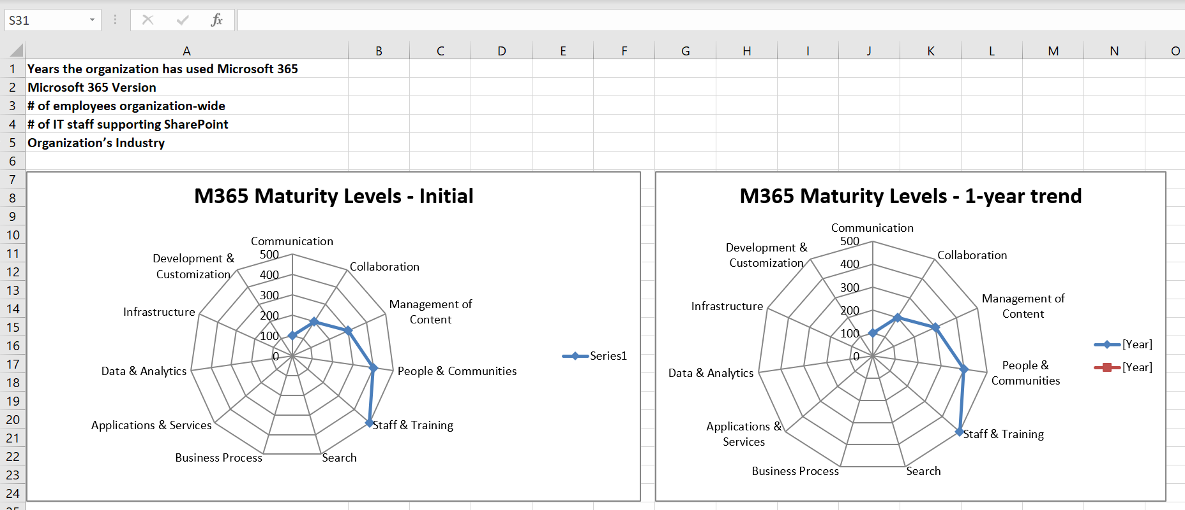
Use the self-assessment to identify your readiness
Notes:
MARC
You should rate yourself before you start as a baseline

Slide 17
DISCUSSION
How you use the
Maturity Model
for Microsoft 365
https://aka.ms/m365-community-docs
Notes:
EMILY

Slide 18

DISCUSSION
Share reactions while others are speaking
Come off mute and share your thoughts
Share your camera, we love virtually meeting you
Raise your hand if someone is speaking
Notes:
EMILY

Slide 19
DISCUSSION #1:
What maturity challenges are you facing in your org?
Notes:
SIMON H

Slide 20
DISCUSSION #2:
How are you using the Maturity Model?
Notes:
SIMON H

Slide 21
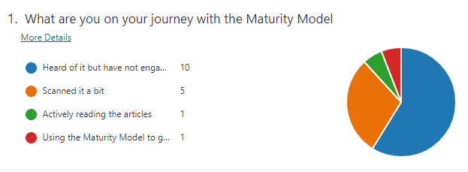
Results of today’s poll

Slide 22
DISCUSSION #3:
Do you have any feedback on the competencies of the Maturity Model?
Notes:
SIMON D
What do you like?
What do you not like?
What are we missing?
Do we have a competency which you cant see the reason for?

Slide 23
MM4M365 Competencies & Artifacts
Published Competencies
Open Competencies
Supporting Articles
Business Process
Data & Analytics
Principles of…
Collaboration
Infrastructure*
Search
Communication
Communication
*In progress
Management of Content
How to elevate…
People & Communities
Communication
Search
People & Communities
Staff & Training
Customization & Development

Slide 24
DISCUSSION #4, PART 1:
What would you like to focus on in the April call?
Notes:
EMILY

Slide 25
DISCUSSION #4, PART 2:
Are you open to these calls being recorded?
Notes:
EMILY

Slide 26
DISCUSSION #5:
Are there any barriers to being involved in the Maturity Model we can help remove?
Notes:
MARC

Slide 27
OVERVIEW
Get involved in the
Maturity Model
for Microsoft 365
https://aka.ms/sharing-is-caring

Slide 28
Opportunities to participate in the community
Present case study (at MMM4M365 Practitioners or other speaking opportunities)
Contribute on GitHub
Provide feedback, insights, tools, and artifacts
Socialize
content

Slide 29
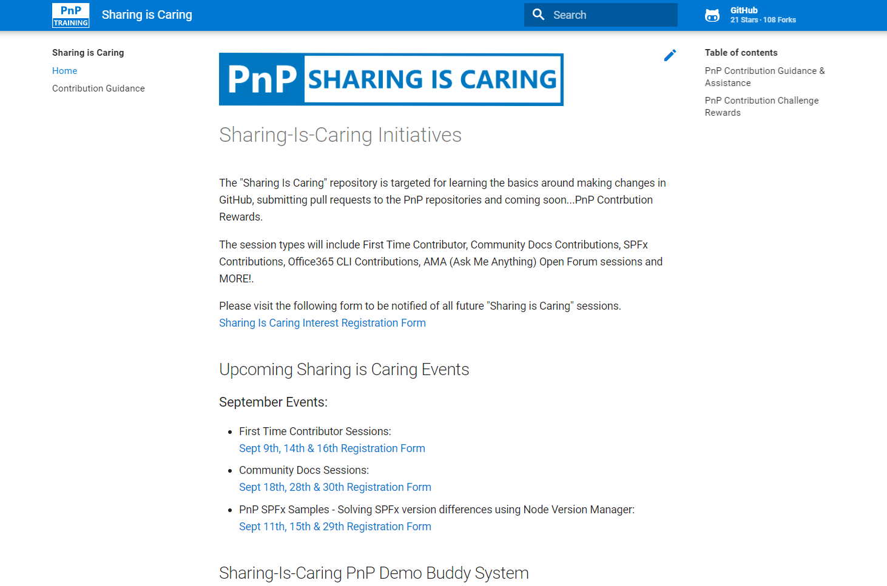

GUIDANCE
Want to get started on the open-source and community work?
Thank you, February attendees
First-Time Contributor Sessions
Monday, March 22nd 9am PST
Alok Kumar Gupta
Andy Dawson
Ashok Gopalan
Brad Chaney
Carl Abrahamson
Charles Emmanuel Saturnin Ndiaye
Charles Ndiaye
Dattatray Patil
Dinesh Bhat
Faizal Khatri
Imke Feldmann
Jeff Thorpe
Jenna Eagleson
Jim Duncan
markc
Mohammad Amer
Natalie Harzic
Patrick Galloway
Reidar Husmo
Shannon Lindsay
Tom Laciano
Vineet Desai
Anthony Kauenhowen
Dattatray Patil
Divya Akula
Mark Cho
Theresa Lubelski
Community Docs Sessions
Tuesday, March 16th 2pm PST
NEW SESSIONS: First Time Presenters Wednesday, March 24th 2pm PST
More than Code with VSCode Tuesday, March 23rd 2pm PST
https://aka.ms/sharing-is-caring

Slide 30
Thank you
Follow us on Twitter
@M365Maturity | @M365CommDocs
Take the Maturity Model Self-Assessment
https://symp.info/MM4M365-SelfAssessment
Fill out the Maturity Model Survey
https://symp.info/MM4M365Survey
Discussions in Github
https://symp.info/MM4M365Discussion
Next MM4M365 monthly call: April 20th at 7:00am PST
Third Tuesday of every month
https://aka.ms/sharing-is-caring

Slide 31


aka.ms/m365pnp

Slide 32
Capability Maturity Model (CMM) provides benchmarks to measure your organization
Level 500
Optimizing
Focus on process improvement
Level 400
Quantitatively Managed
Processes are measured and controlled
Level 300
Defined
Processes documented for the organization and is proactive
Level 200
Managed
Processes documented for projects and often reactive
Level 100
Initial
Processes unpredictable, undocumented, poorly controlled and reactive
Source: https://en.wikipedia.org/wiki/Capability_Maturity_Model_Integration
Notes:
The MM4M365 is based on the Capability Maturity Model which was created in 1986.
The CMM was designed to help organizations build better software and is founded in software development process and has 5 levels running from Level 1 to Level 5, the Holy Grail (and often as elusive!).
Level 1 - Initial
The model starts at Level 1 which is the intro level, where things are chaotic and processes are not documented, poorly controlled and react to the environment that they exist within.
Level 2 - Managed
Managed is where things start to improve and some effort is made to document the processes. However, the processes are not enforced and vary from one area of the business to another. The processes are still not well thought out and are often reacting to their environment.
Level 3 – Defined This really takes us up a notch and processes are documented and now enforced so that they are consistent across the organization. More thought has been put into them and they are proactive.
Level 4 – Quantitatively Managed
This level takes those documented processes which are being consistently applied across the business and adds measures to them so that we can see how effective they are. Its interesting to see how these principles are so similar to agile approaches.
Level 5 – Optimizing
As I mentioned this is the holy grail now that we have measured processes in place we can start to tweak the process and see how that affects their performance. We can experiment and choose the tweaks which provide improvement.

